Slide 1
i DESIGN
E-SWACHH BHARAT

Slide 2
What is E-Bike
Electric Bikes consist of a modified or custom bicycle frame with pedals but include an electric motor, usually in the form of a hub motor, mid-drive motor or belt drive connected to the rear wheel. They allow a rider to either pedal the bike or leverage the power of a battery and motor drive system.
To use an electric bike you have to charge the battery, turn the controller system on and then twist a throttle, pull a trigger or pedal the bike forward to initiate the motor drive system. Throttle only drive behaves much like a traditional gas powered scooter because the rider doesn’t have to pedal, the bike just goes! By contrast, pedal-assist mode uses the rider’s input as the throttle signal and is more popular in Europe where bicycle laws are a bit more restrictive regarding motor and battery power. European bikes are usually limited to 250 Watt motors whereas the US has many bikes with motors as strong as 500 or even 600w. These bikes go faster and can power up steeper hills more easily.

Slide 3
E-SWACHH BHARAT

Slide 4
Specifications
Weight : 45kgs
Efficiency : 60 km per charge
Speed : 50 km/hr
Batteries : Lead-Acid batteries
Charging time : 4 hrs
Motor capacity : 800 watts
Load bearable : 160kgs
Motor type : Hub motor

Slide 5
Main parameters of e bike
Motor
Batteries
Controller
Brakes
Design
Analysis
Throttle
Welding

Slide 6
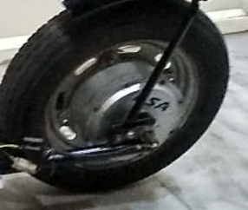
Motor
Hub motors are electric motors that are housed inside the hub of either the front or rear wheel.
These are the most common motor that you will find on an electric bike (although mid drives are becoming very popular in certain markets).
There are direct drive hub motors that use the whole hub shell as the electric motor. And there are geared hub motors that have a smaller internal motor with planetary gears that drive the hub shell. Here is a comparison of direct drive and geared hub motors.
In addition, there is an emerging number of all-in-one hub or wheel systems that house all of the e-bike components (motor, battery, controller) in the hub or wheel.
Here is an overview of front hub, rear hub, and all-in-one hub motors with their pros & cons.

Slide 7
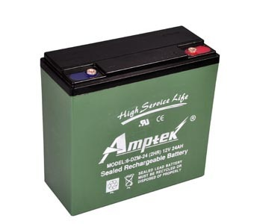
Batteries
Lead-acid Electric Bike Batteries (SLA)
Lead-acid electric bike batteries are cheap and easy to recycle. However, they are sensitive to bad treatment, and they don’t last very long.
Lead-acid batteries are cheap for several reasons: they weigh twice as much as NiMh batteries, and three times as much as lithium batteries. They have much less usable capacity than NiMh batteries or lithium batteries. They only last for half as long as nickel or lithium batteries.
Warning: if a cheap electric bike is advertised and the advert does not state what kind of battery it has, you can pretty much be certain that it has a lead-acid battery. It might be cheap. This battery type might be good enough if you want the bike for small distsance.

Slide 8
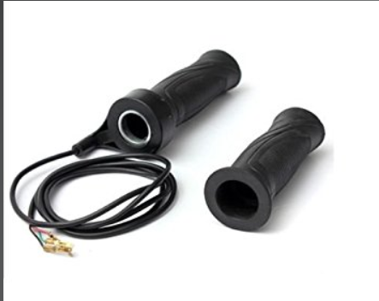
Throttle
Your electric bicycle’s throttle is the physical connection between you and your ebike. Through just a few square centimeters of surface area, a magical bond is formed between man and machine that allows the two to feel each other and respond to each others thoughts and desires.
Full twist throttles are sort of the antithesis of thumb throttles as they are the largest type of ebike throttle and require the whole hand to operate. The full twist throttle takes up the entire end of the handlebar, completely replacing whatever grip would originally be on the end of handlebar. To operate it, the rider simply grabs a handful of throttle and twist it back towards himself.
Anyone who has ridden a motorcycle or moped will find the full twist throttle familiar. It operates just like the throttle on most motorcycles. Many people prefer full twist throttles because they are operated by the full hand – all five fingers grip that sucker. That allows you to hold on tight, handle well and use your wrist instead of your thumb to apply the twisting motion.

Slide 9
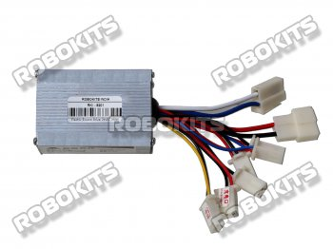
Controller
The mechanism of an electric speed controller varies depending on whether you own an adaptive or purpose-build electric bike. An adaptive bike includes an electric drive system installed on an ordinary bicycle. A purpose-built bike, more expensive than an adaptive bike, provides easier acceleration and affords more features. The mechanism of electric bike speed controller varies in these two types.
Controller Specifications:
Voltage: DC 24V
Maximum Current: 25 Amps
Wattage: 350W Throttle : 1-4V
Level Brake: high / low
Under Voltage Protection: 20.5 Volts
Includes attachments for motor, accelerator, brake, battery, battery charging, brake light, power lock

Slide 10
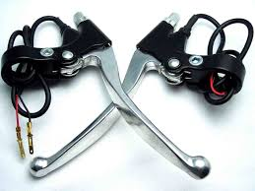
Brakes
When building an ebike make sure to install ebrakes. Ebrakes are an essential part of your system and cannot be overemphasized enough, as they cut power to the motor (or also engage the regen braking when you pull the lever, if you have a direct drive hubmotor). Most factory built bikes include this as standard, as do many kits.
Fig.2.4.1
For anyone who does not think ebrakes are necessary in an ebike look at this video out of China as a clear illustration why ebrakes are a good idea:
One big fear for an ebike builder is that their throttle gets locked in wide open throttle position (WOT) as happened to the woman in the video. This can sometimes happen if moisture shorts the internal. The ebrake can be a safeguard that will from keep this from happening.
Generally the more powerful the motor on your ebike, the more needed ebrakes are. If you are confident your brakes are more powerful than the motor , and your brakes are strong enough to easily lock the rear wheel if the throttle gets stuck in wide open throttle…then you may be able to argue against ebrakes. For example if you all you have is a 250 watt geared hub motor and you have hydraulic disc brakes properly adjusted…you really have no need for ebrakes. If you have a Cyclone kit 3000 watts and you got it over-volted to 7000 watts …going without ebrakes would be considered hazardous.

Slide 11
Welding
Gas tungsten arc welding (GTAW), also known as tungsten inert gas (TIG) welding, is an arc welding process that uses a non-consumable tungsten electrode to produce the weld. The weld area and electrode is protected from oxidation or other atmospheric contamination by an inert shielding gas (argon or helium), and a filler metal is normally used, though some welds, known as autogenous welds, do not require it. A constant-current welding power supply produces electrical energy, which is conducted across the arc through a column of highly ionized gas and metal vapors known as a plasma.
GTAW is most commonly used to weld thin sections of stainless steel and non-ferrous metals such as aluminum, magnesium, and copper alloys. The process grants the operator greater control over the weld than competing processes such as shielded metal arc welding and gas metal arc welding, allowing for stronger, higher quality welds. However, GTAW is comparatively more complex and difficult to master, and furthermore, it is significantly slower than most other welding techniques. A related process, plasma arc welding, uses a slightly different welding torch to create a more focused welding arc and as a result is often automated

Slide 12
Benefits
The benefits of electric bikes are many and often go unrealized by car and scooter owners. In my opinion they include the following:
No driver license or insurance required to ride
Can be used on sidewalks and to cut through parks
Lighter, cleaner and more reliable than gas powered vehicles
Less expensive than gas powered vehicles, especially over the long term when using electricity vs. gasoline or other fuel source
Safer than street-legal scooters or motorcycles because they run slower and are not fully usable on highways or high-speed intersections
Easily avoid and skip through congested traffic areas
Environmentally friendly, no exhaust created on site for the user to inhale. Easily use locally produced solar or wind power to charge
Efficient and affordable parking options, fits on any normal bike rack or to a pole/railing
Easy to use with public transportation like busses, trains and light rail systems
Provides an opportunity to exercise and practice balance
Social opportunity to get in touch with your community and become more social.

