Slide 2
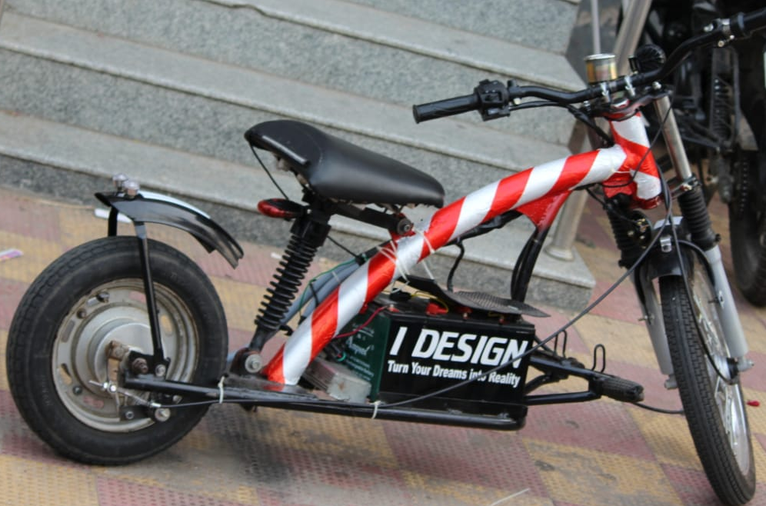
E- SWACHH ID LIGHT WEIGHT E-BIKE TEAM ID- 01
As the world is changing, we have to change for the environment ... Lets transform all biofuels to e -fuel and make environment free.

Slide 3
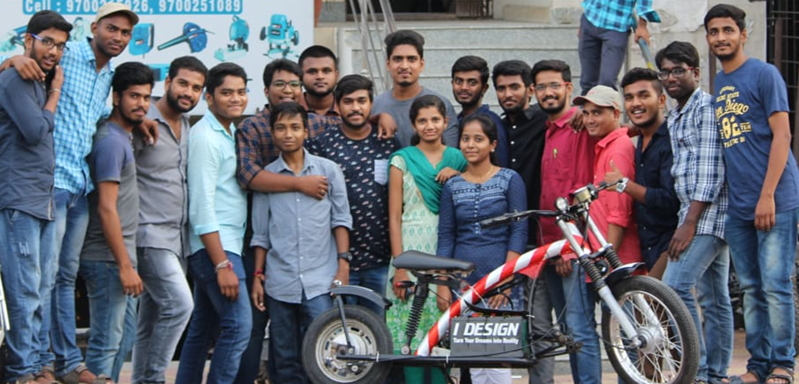
TEAM ID-01

Slide 4
“I-DESIGN” is a new start-up ,which gives a platform for mechanical engineering students who are willing to make their ideas into reality.
- G.V.RAVITEJA

Slide 5
“I-DESIGN” is an emotion in bringing up the dreams into reality by mighty engineers of future India by a fabulous designs well versed with top class ergonomics. Just with the inspirational words from our youth icon Sri. KTR garu, We came up with concepts of "SAVE FUEL-SAVE WORLD" and "MAKE IN INDIA“. We fabricated a E-BIKE which is helpful to tackle the situations in traffic, Ease of ride, very economical at affordable price and compatible to every age group with outstanding performance at operating conditions. "DON'T RIDE A BIKE TO ADD DAYS TO YOUR LIFE, RIDE A BIKE TO ADD LIFE TO YOUR DAYS"

Slide 6
What is E-Bike?
Electric Bikes consist of a modified or custom bicycle frame with pedals but include an electric motor, usually in the form of a hub motor, mid-drive motor or belt drive connected to the rear wheel. They allow a rider to either pedal the bike or leverage the power of a battery and motor drive system.

Slide 7
SPECIFICATIONS
Weight : 45kgs
Efficiency : 60 km per charge
Speed : 50 kmph
Batteries : Lead-Acid batteries
Charging time : 5 hrs
Motor capacity : 800 watts
Load bearable : 160kgs
Motor type : Hub motor

